Slide 1

ScanMasterX Team No 10: UwUltimate Stardust Crusaders

Slide 2





Team Details
Dennis
Eric
Lewis
Alexa
Will

Slide 3
Project Overview
ScanMasterX seeks to lower the barrier of entry to analyzing and understanding the security of a network.
Scans for IP addresses within a network
Scans the ports located at specified IP addresses
Displays the topology of the IP addresses found on a network
Attempts a simple exploit

Slide 4
Requirements List
R1:………….
R2:……….
(Please Be concise)

Slide 5
Project Solution Approach
Major Components
Custom scanner leveraging Nmap
GUI for user to interact with
Tools, Frameworks, Platforms, Libraries
PYQT - UI framework for Python
NMAP – A CLI network scanner
CVE Database [TBD]

Slide 6
System Architecture Diagram

Slide 7
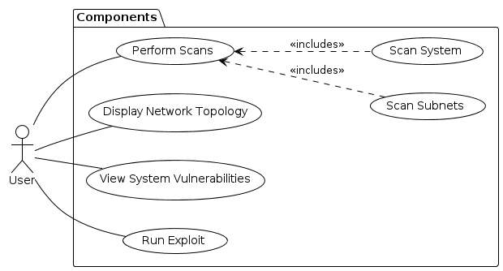
Use Case Modeling

Slide 8
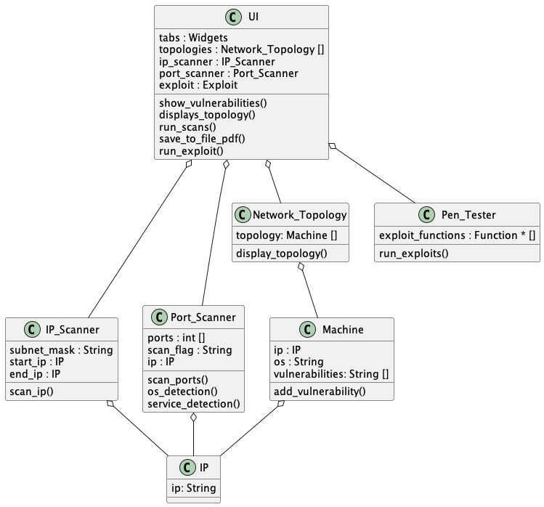
Structural Modeling: Class Diagram

Slide 9
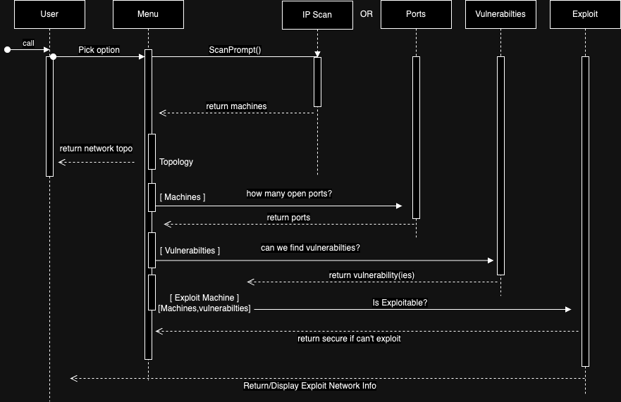
Behavioral Modeling: Sequence Diagram

Slide 10
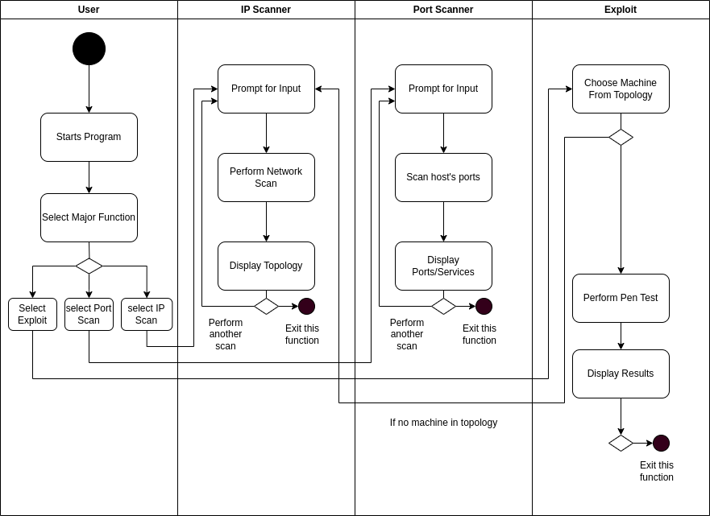
Behavioral Modeling: Activity Diagram

Slide 11
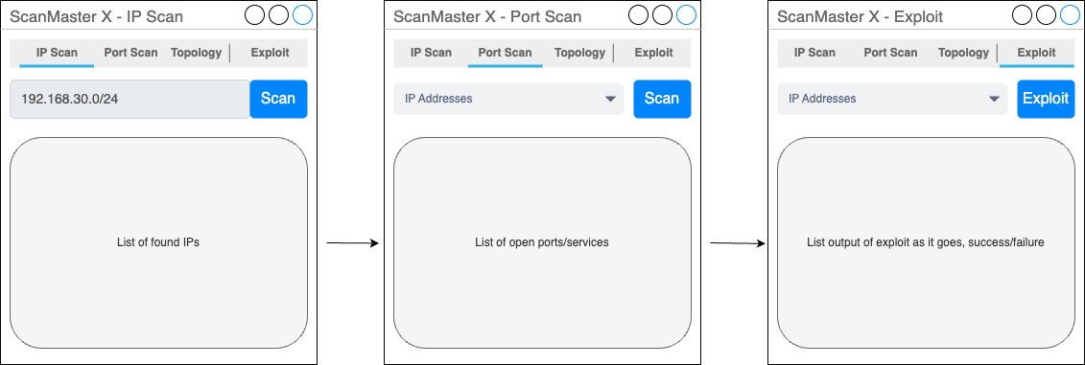
Screenshots (UI, Code, if any)

Slide 13
What’s Next??
Implementation

